Slide 1

Pattern Classification
All materials in these slides were taken from
Pattern Classification (2nd ed) by R. O. Duda, P. E. Hart and D. G. Stork, John Wiley & Sons, 2000 with the permission of the authors and the publisher

Slide 2
Chapter 2 (part 3)
Bayesian Decision Theory (Sections 2-6,2-9)
Discriminant Functions for the Normal Density
Bayes Decision Theory – Discrete Features

Slide 3
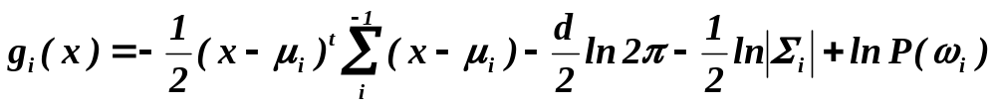
Discriminant Functions for the Normal Density
We saw that the minimum error-rate classification can be achieved by the discriminant function
g_{i}(x) = ln P(x | ω_{i}) + ln P(ω_{i})
Case of multivariate normal

Slide 4
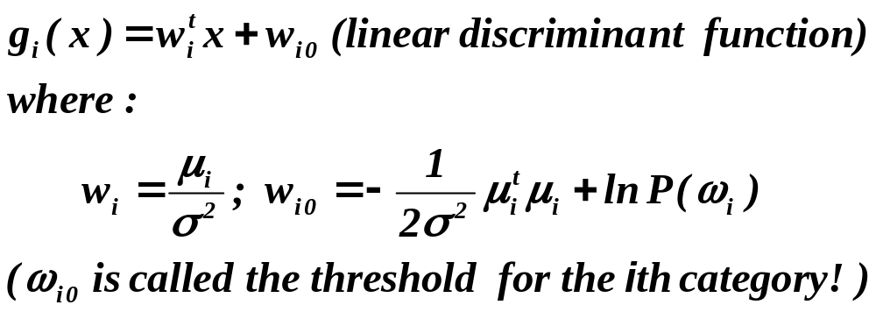
Case Σ_{i} = σ².I (I stands for the identity matrix)

Slide 5
  A classifier that uses linear discriminant functions is called “a linear machine”
  The decision surfaces for a linear machine are pieces of hyperplanes defined by:
g_{i}(x) = g_{j}(x)

Slide 6
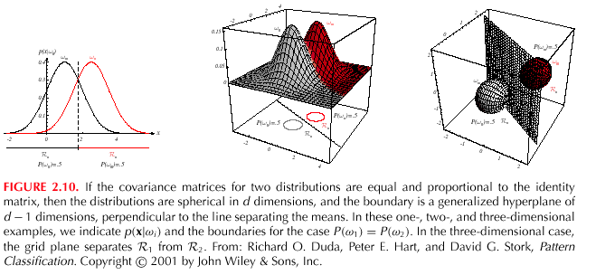

Slide 7
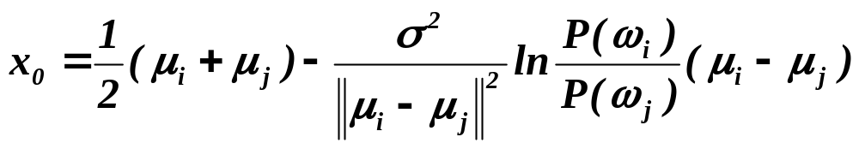
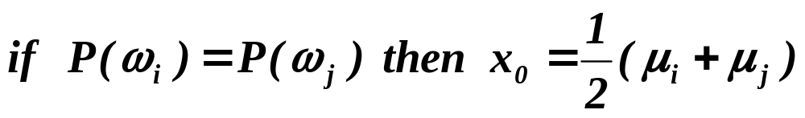
  The hyperplane separating R_{i} and R_{j}
always orthogonal to the line linking the means!

Slide 8
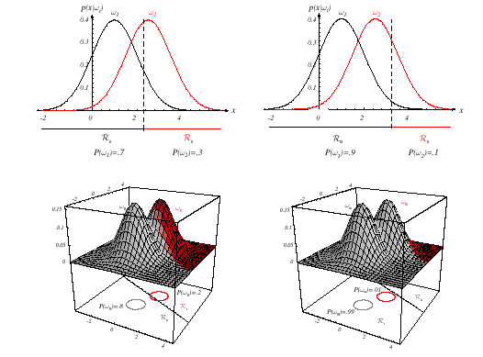

Slide 9
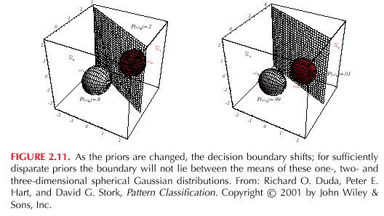

Slide 10
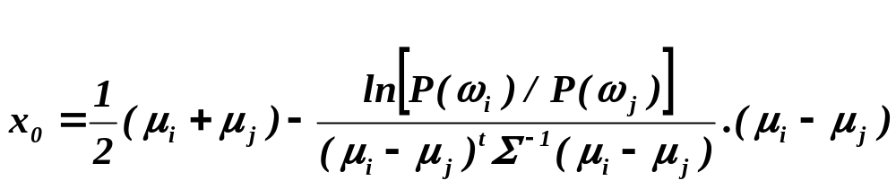
Case Σ_{i} = Σ (covariance of all classes are identical but arbitrary!)
  Hyperplane separating R_{i} and R_{j}
  (the hyperplane separating R_{i} and R_{j} is generally not orthogonal to the line between the means!)

Slide 11
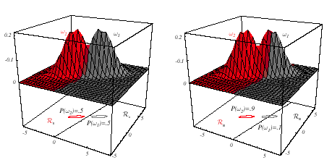

Slide 12
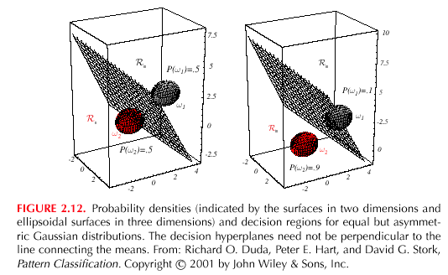

Slide 13
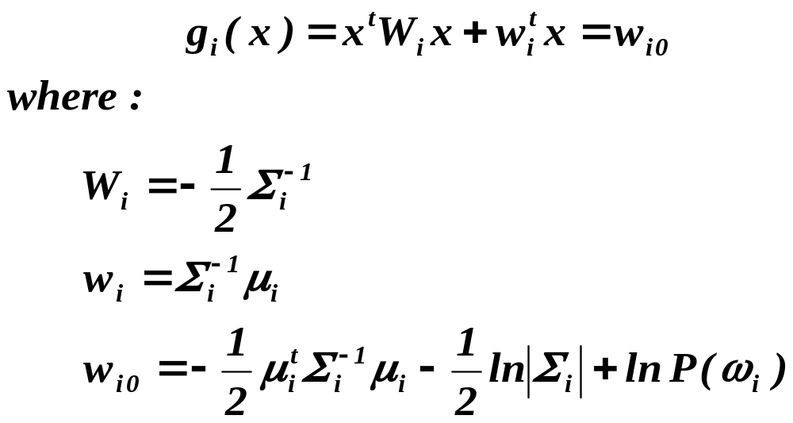
Case Σ_{i} = arbitrary
  The covariance matrices are different for each category
  (Hyperquadrics which are: hyperplanes, pairs of hyperplanes, hyperspheres, hyperellipsoids, hyperparaboloids, hyperhyperboloids)

Slide 14
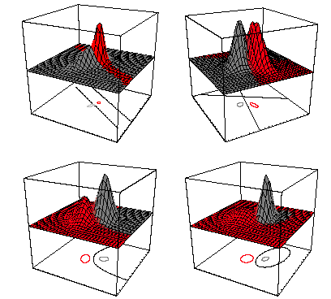

Slide 15
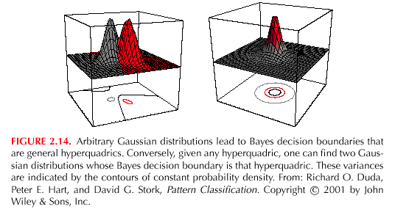

Slide 16
Bayes Decision Theory – Discrete Features
Components of x are binary or integer valued, x can take only one of m discrete values
v₁, v₂, …, v_{m}
Case of independent binary features in 2 category problem
Let x = [x₁, x₂, …, x_{d} ]^{t} where each x_{i} is either 0 or 1, with probabilities:
p_{i} = P(x_{i} = 1 | ω₁)
q_{i} = P(x_{i} = 1 | ω₂)

Slide 17
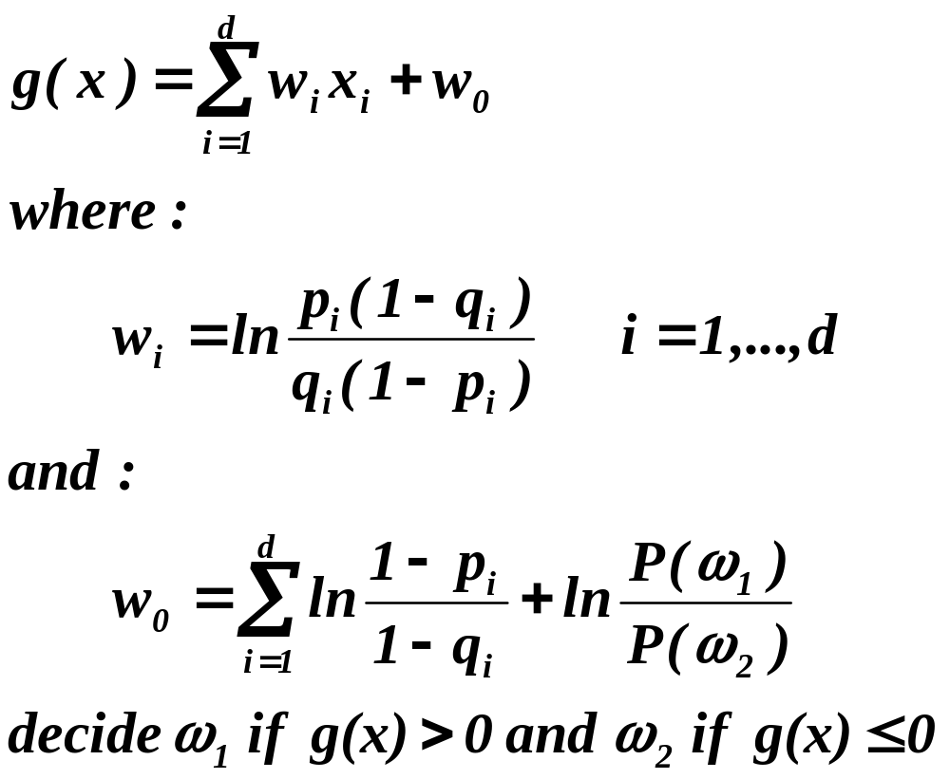
The discriminant function in this case is:

